Slide 1
Current Coupon Model

Slide 2
Current Coupon Marking
Empirical approach of current coupon modeling
Risk neutral approach
Primary and secondary spread
Impact on mortgage pricing

Slide 3
What is current coupon
Semiannual equivalent yield of the hypothetic parity priced TBA
Headline indicator of Agency MBS performance
Secondary mortgage market
Fannie, Freddie, Ginnie, Ginnie II: 15, 20, 30 years

Slide 4
Marking methodology
1. Calculate 30d (45d) forward price + accrued interest from front and back 1 TBA for each coupon
Why 30 day forward? → consistent with mortgage originator business practice
2. Find lower and upper coupon TBA based on 30d forward price + accrued interest
Front
SD_{F}
Back 1
SD_{B1}
Back 2
SD_{B2}
Back 3
AD
SD_{B3}

Slide 5


Marking methodology (cont.)
Interpolation is straightforward if both discount and premium forward prices are available
If N/A, Extrapolation
1. Linear extrapolation (instable, missing convexity)
2. Implied/Regress by coupon swap (numerical instable)
3. Quadratic regression by (premium/discount coupon – cc) over (px over par)
$$x=\frac{{SD}_{B1}− (AD+30)}{{SD}_{B1}−{SD}_{F}}$$
$${PV}_{30d}=x∙{PV}_{F}+\left(1−x\right)∙{PV}_{B1}+c∙\frac{d}{360}$$

Slide 6
Marking methodology (cont.)
Collect 100 business days TBA data for the 3 cheapest premium TBA
Regress a quadratic function over points defined as (TBA coupon – current coupon, TBA price -100.0) without intercept

Slide 7
Marking methodology (cont.)
When does this happen
Big market rallies in 2012-2013 with LSAP or
Big selloffs
A reliable cc marking should
Reflect MBS return correctly
Reflect market volatility
a good start for cc modeling

Slide 8
Current Coupon Model
Forward *projection* of cc, most important MBS model component
Econometrics based model (Q2): historical time series analysis
Pricing based model (Q3): risk neutral/backward induction

Slide 9
Embedded options and negative convexity
The uncertainty of mortgage cashflow comes from the fact that US mortgagor has the right to prepay without penalty
Borrowers long both a put options to mortgage rates and a call option to home price, hence negative convexity

Slide 10
Mortgage Basis

Slide 11
Mortgage Basis vs OAS
Two valuation measures commonly referred by MBS investors
Measure cheapness or richness of mortgage from a historical standard point of view or a relative point of view, comparing with other assets
mortgage basis which is cc over blend of treasuries/swaps is model independent; usually over 5 year treasury or 10 year treasury or blend of the two; which does not track the cc duration all the time
OAS is common model based analysis which accounts for timing of the cashflow, interest rate volatility, and optionality
Pros and Cons
Basis is straight forward and model independent
OAS is model dependent and it takes into account for cc duration and convexity changes over time

Slide 12
Mortgage Basis Drivers
Swap spread
Curve slope
Interest rate vol (such as swaptions)
Refinance propensity
Performance of competing spread products, such as IG-spread
Basis is straight forward and model independent
OAS is model dependent and it takes into account for cc duration and convexity changes over time
Risk appetite
Widen during crisis due to flight-to-safety
Monetary policy
Dynamics gets tricky when fed purchased MBS and treasury at the same time with QEs(tailwind to both mortgages and treasury)

Slide 13
Mortgage Basis Drivers

Slide 14
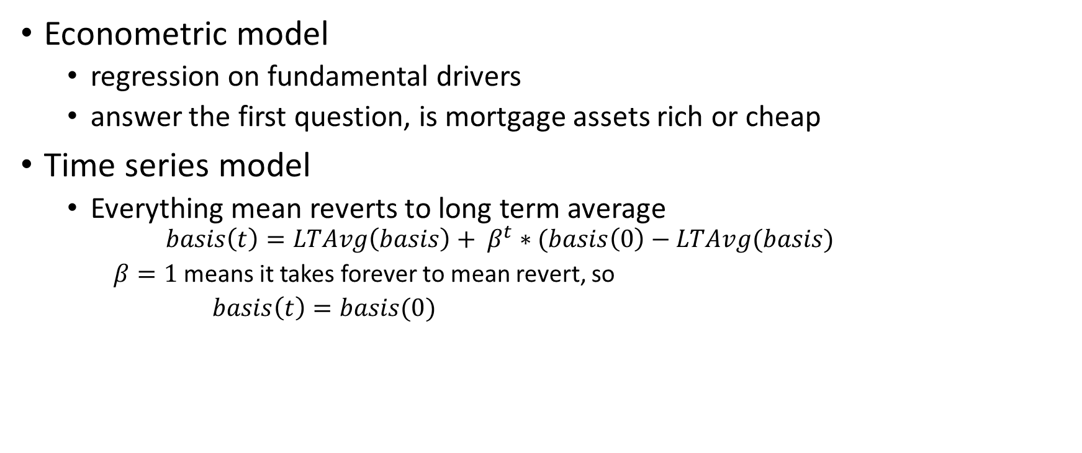
One Basis, two worlds
Econometric model
regression on fundamental drivers
answer the first question, is mortgage assets rich or cheap
Time series model
Everything mean reverts to long term average
$$basis\left(t\right)=LTAvg\left(basis\right)+ β^{t}∗(basis\left(0\right)−LTAvg(basis)$$
$β=1$ means it takes forever to mean revert, so
$basis\left(t\right)=basis(0)$

Slide 15
But
Long term average can change with market structure change
Less demand to hedge under low vol environment which keeps suppress vol (positive feedback mechanism)
mortgage extend when rates sold off, so mortgage investors have to sell more rates to stay neutral
QE buys, reinvests proceeds, tapers at different time/pace, with different preference on instruments

Slide 16
Primary & secondary mortgage market
Step 1:
Rate Lock Volumes
Predict Pull Thru
Hedge pipleline
Step 2:
Close Loans
Send Loans to GSE’s
Receive Cusips
Step 3:
Sell CUSIPs to Street
Buyback TBA
Step 4:
Dealers sell CUSIPS to investors
GSE’s
CUSIPs
Loans & Fees
Homeowners
Originators
Investors
Cash
Mortgage
Sell TBA
To Hedge
Pipeline
TBA
CUSIPs
Cash/TBA
CUSIPs/TBA

Slide 17
First Constant Assumption
Constant TBA assumption(monthly TTB observable for dealers)
T0 constantness, does not mean it is static
W2D, most convexity, worst carry depends on premium/discount and it could change dramatically over time
Excludes most spec stories with a payup
Fast deliverables for premium – big bal, high fico, fully ramped but not seasoned enough
Most extendable for discount – big bal, low fico,
WAC spread could change dramatically over time
Market driven (best execution depends on
coupon swap
buy up/buy down multiplies
MSR valuation vs buyup (widen when excess IO MSR valuation is rich)
Policy driven (UMBS cap on WAC spread, widen)

Slide 18
Spec stories ( 2019/04/25)
FN 30YR | LLB |  | MLB |  | HLB |  | HLB2 |  | 200K |  | CK |  | FICO<700 |  | NY
 | Pay-Up | %Theo | Pay-Up | %Theo | Pay-Up | %Theo | Pay-Up | %Theo | Pay-Up |  | Pay-Up |  | Pay-Up | %Theo | Pay-Up | %Theo
3 | 0-12 | 36% | 0-08 | 27% | 0-06 | 21% | 0-02 | 12% | 0-00 |  | -1-06 |  |  |  | 0-00
3.5 | 1-02 | 48% | 0-30 | 54% | 0-25 | 58% | 0-19 | 69% | 0-12 |  | -1-00 |  |  |  | 0-20 | 64%
4 | 1-26 | 63% | 1-16 | 62% | 1-08 | 69% | 1-01 | 91% | 0-26 |  | -1-04 |  |  |  | 1-22 | 104%
4.5 | 3-02 | 94% | 2-21 | 99% | 2-04 | 106% | 1-23 | 145% | 1-06 |  | -1-16 |  |  |  | 2-14 | 126%
5 | 3-22 | 73% | 3-08 | 75% | 2-16 | 67% | 1-28 | 70% | 1-12 |  |  |  |  |  | 2-28
5.5
6
FN 30YR | 2017 |  | 2016 |  | 2015 |  | 2014 |  | 2013 |  | 2012 |  | 2011 |  | 2010 |  | 2009 |  | 2008
 | Pay-Up |  | Pay-Up |  | Pay-Up | %Theo | Pay-Up | %Theo | Pay-Up | %Theo | Pay-Up | %Theo | Pay-Up | %Theo | Pay-Up | %Theo | Pay-Up | %Theo | Pay-Up | %Theo
3 | 0-06 |  | 0-08 |  | 0-12 | 45% | 0-18 | 66% | 0-20 | 49% | 0-22 | 52%
3.5 | 0-10 |  | 0-12 |  | 0-18 | 40% | 0-26 | 57% | 1-00 | 52% | 1-02 | 53% | 1-00 | 49% | 1-00 | 48%
4 | 0-18 |  | 0-20 |  | 0-24 | 39% | 1-08 | 61% | 1-16 | 66% | 1-16 | 55% | 1-16 | 55% | 1-16 | 56% | 1-16 | 56%
4.5 | 0-20 |  | 0-22 |  | 1-00 | 38% | 1-16 | 62% | 1-22 | 66% |  |  | 1-20 | 54% | 1-20 | 55% | 1-20 | 55%
5 |  |  |  |  |  |  |  |  |  |  |  |  | 1-00 | 21% | 1-04 | 24% | 1-08 | 27% | 1-08 | 31%
5.5
6
FN 30YR-LTV | 80 - 90 |  | 90 - 95 |  | 95 - 100 |  | 100 - 105 |  | > 105 |  | CR >125
 | Pay-Up | %Theo | Pay-Up | %Theo | Pay-Up | %Theo | Pay-Up | %Theo | Pay-Up | %Theo | Pay-Up | %Theo
3
3.5
4
4.5
5

Slide 19
TBA Assumptions in use
WAC = current coupon + wac_spread (115 bps), much higher wac spread
WALA ~ 20-30, fully ramped
Lnsz = 300K, much higher avg loan size recently
Ltv = 70 ~ 75
Fico = 750
State = US (non NY)
Purpose = Refi (usually should be purpose break down by %)
Occupancy = investor (purpose break down by occupancy %)

Slide 20
Second Constant Assumption
Constant cc OAS – Often referred as risk neutral in mortgage world
Means OAS is independent of rates level, slope and volatility,
Doesn’t mean OAS can’t change with other factor of the market
Foundation of option adjusted analysis
Constant OAS and parallel rate shock
Mortgage does not trade rate directional
Show OAS change vs PCA1/PCA2

Slide 21
Advantages
Coherent approach
Nonlinearity is embedded
Not based on any history cc/rate relation (except prepayment model should be) which dynamics could change over time
Constant basis assumption vs constant OAS for current coupon
Most empirical cc models are based on constant spread
Constant cc OAS is a much better assumption (lower vol) by empirical data

Slide 22
Disadvantage
Require close monitoring potentially frequent re-calibration
Coherent but KRDs are not observable, needs some expertise and effort to refine; eg. calibrate to empirical duration
OAS

Slide 23
Potential tests
Heuristic approach depends on prepayment model
Depends on but not very sensitive to model performance as long as it is reasonably good
Depends on the way incentive is defined:
Popular definition is PV of monetary savings, then save moneyness will mean less incentive in higher rate environment due to discounting
Depends on term structure model
Normal vs lognormal model
How interest rate volatility skew is modeled

